Slide 1
Survey of zoonotic viruses in wildlife and
human contacts in Chiang Mai Province
การสำรวจไวรัสที่ติดต่อระหว่างคนและสัตว์ในสัตว์ป่าและผู้สัมผัสสัตว์ป่า
ในจังหวัดเชียงใหม่
PREMMARIN INMONTHIAN
Research assistance of LUCENT international collaboration
AMS-CMU

Slide 2
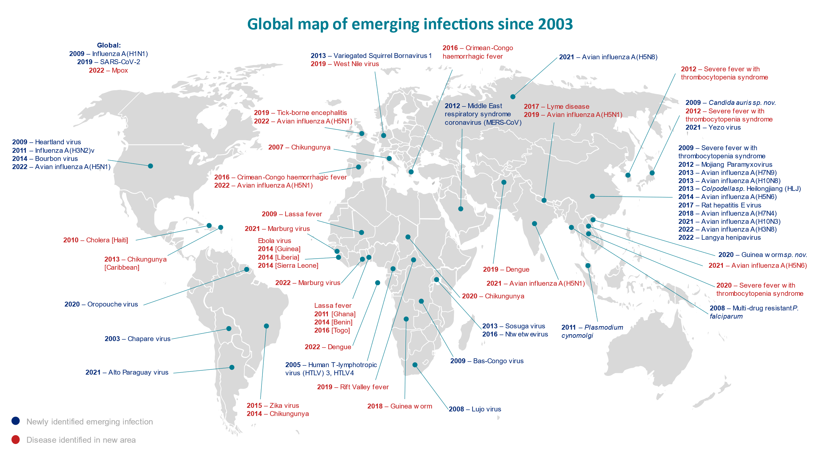
Background: Emerging and Re-emerging diseases
Emerging disease: Diseases recognized in humans for the first time.
Remerging disease: Diseases that have historically infected humans but continue to re-appear.
Between 60%-80% of
emerging infections
are derived from animal sources
Zoonotic diseases
2
GuidanceEmerging infections: how and why they arise-GOV.UK5Jan2023
https://www.gov.uk/government/publications/emerging-infections-characteristics-epidemiology-and-global-distribution/emerging-infections-how-and-why-they-arise

Slide 3
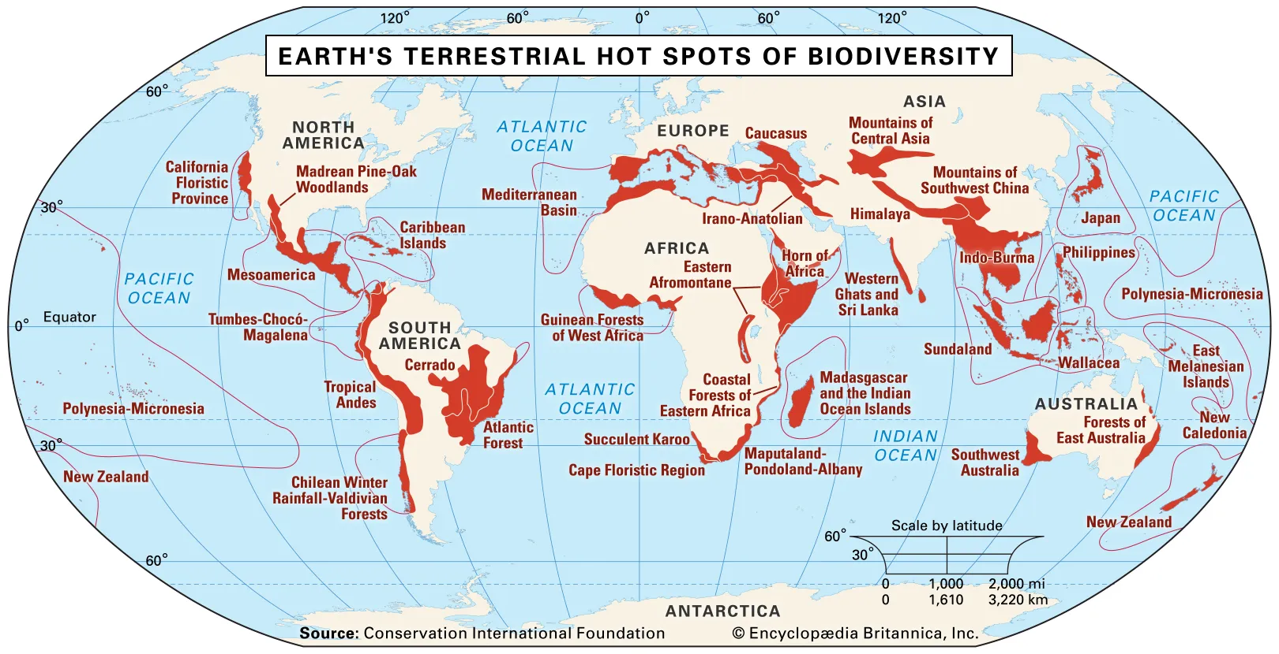
Background: Emerging and Re-emerging diseases
Southeast Asia (SEA):
Global hotspot of biodiversity.
viral zoonoses
Nipah/Hendra virus
Avian influenza
Swine influenza
SARS
COVID-19
3

Slide 4
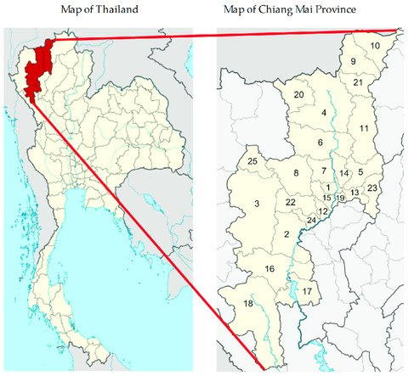
Background: Chiang Mai and emerging diseases
Potential area for zoonotic viral emergence
Large biodiversity
70% of the area of Chiang Mai province includes forest
Local community activities; i.e. wildlife consumption
Intensive agriculture and economic development
4

Slide 5
CONCEPTUAL FRAMEWORK
Agents/
pathogens
Wildlife animals
Spillover
Spread
Emerging/
Outbreak
Humans
Reservoir/Asymptomatic host
Health impact
Social & economic impact
Climate change
Loss biodiversity
Human activity
Deforestation.
Land use change
Hunting
Wildlife trading
PREPAREDNESS
Technology
Knowledge
Biological factors
Identification of potential zoonotic pathogens
Early detection and diagnosis
Identification of animal reservoirs
Identification of behavior risks of exposure and susceptible human populations
Stakeholders advise
Development of economic
New Silk Road corridor
economic factors
Developing surveillance system and more effective response strategies
5

Slide 6
Research question
What is the risk of viral spillover
between wildlife and high-risk populations
in Chiang Mai province?
6

Slide 7
Objectives
To explore the circulation of potential zoonotic viruses among high-risk populations in Chiang Mai Province
1
To assess the serological prevalence of potential zoonotic viruses and perform concurrent behavioral questionnaire among high-risk populations in Chiang Mai Province
2
To explore the circulation of potential zoonotic viruses among wildlife in Chiang Mai Province
3

Slide 8
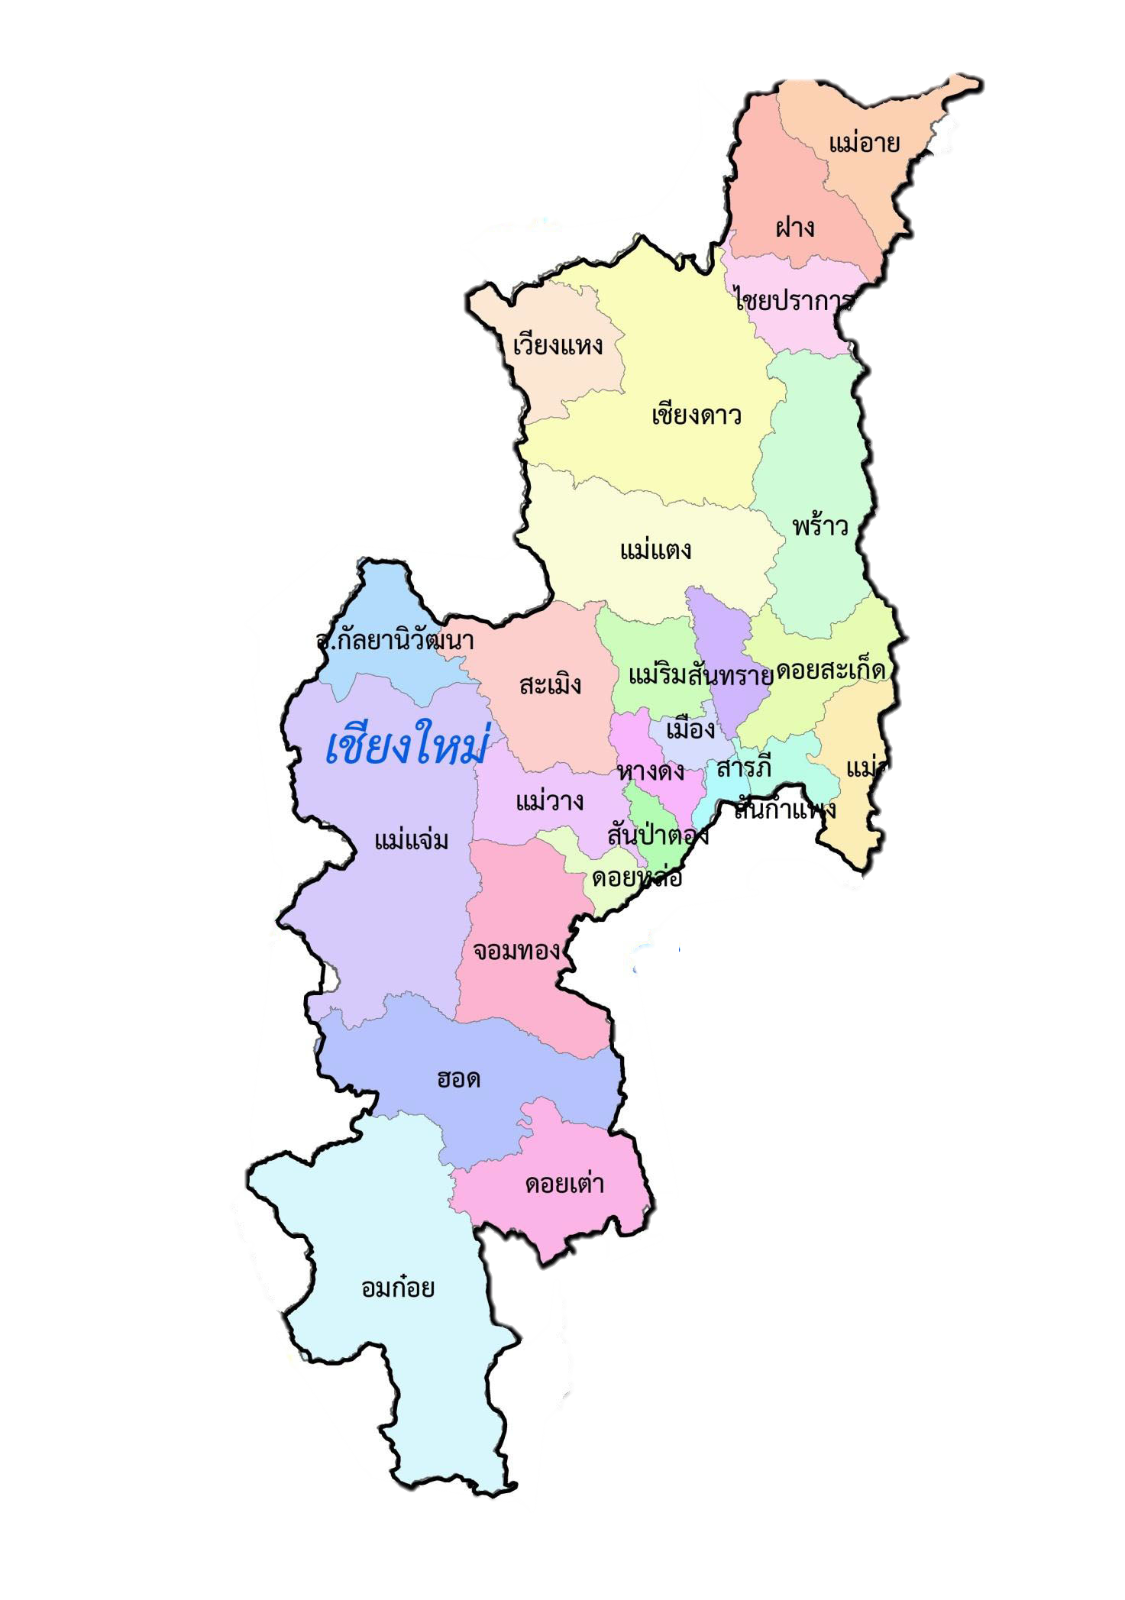
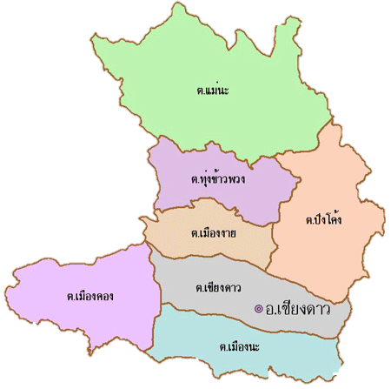
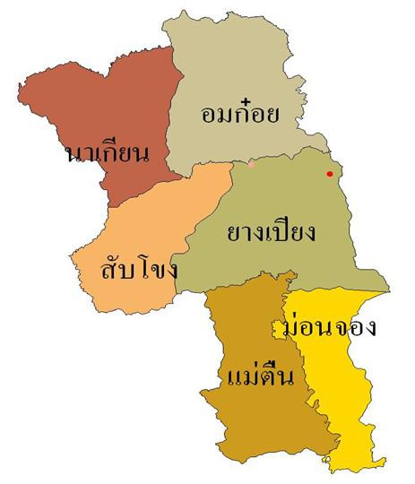
Scope of the study
Chiang Dao
Study sites
Chiang Dao district (site A)
Omkoi district (site B)
3 visits/ site
Volunteers and wildlife
Human: High-risk populations 30 persons/site/visit
Wildlife: 10 animals/site/visit
Omkoi
8

Slide 9
Scope of the study
High-risk population
Wildlife
Behavioral questionnaire
Sample collection
Sample collection
Antibodies against
Influenza viruses
Coronaviruses
Hantaviruses
Niphaviruses
Poxviruses
Nasopharyngeal swab/
Blood?
Blood collection
Nasopharyngeal swab
Antibody testing for potential zoonotic pathogen
using ELISA technique
Identify potential pathogens
Using NGS technique
Identify potential pathogens
using NGS technique
Analysis of Human-pathogens animal interfaces
9

Slide 10
Outputs and Outcomes
Potential zoonoses pathogens in high-risk human population and wildlife
Past exposure to zoonotic viruses in high-risk population
Human behavior risk for zoonotic infections
Human-pathogen-animal Interface
Increase awareness on zoonotic diseases, emerging/re-emerging disease
Reduce impact of outbreak/emerging
Preparation and prevention for the possible outbreak, Alert system
10

Slide 11
Acknowledgements

