Slide 1
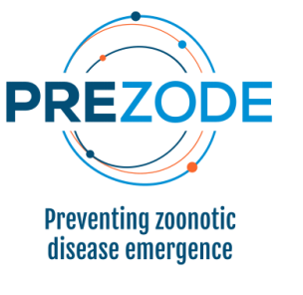
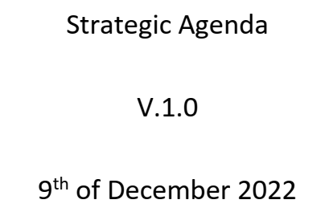
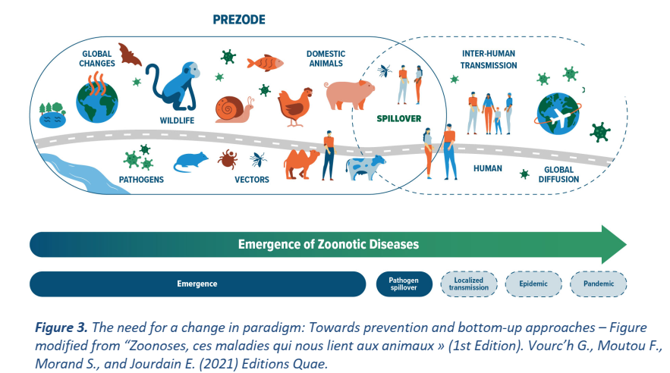

Slide 2
December 1st 2021

Slide 3
Enhancing collaboration, coordination, communication and capacity building

Slide 4
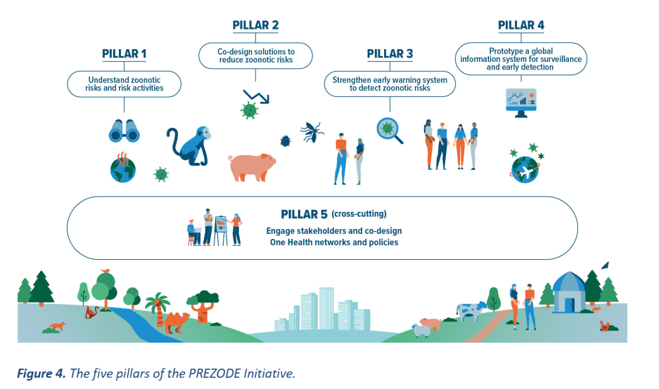

Slide 5
A definition of prevention of zoonotic spillover to humans
Shifting the infectious disease control paradigm from reactive to proactive (Primary prevention). Prevention includes addressing the drivers of disease emergence, namely ecological, meteorological and anthropogenic factors and activities that increase spillover risk, in order to reduce the risk of human infection. It is informed by, amongst other actions, biosurveillance in natural hosts, people and the environment, understanding pathogen infection dynamics and implementing intervention activities.

Slide 6
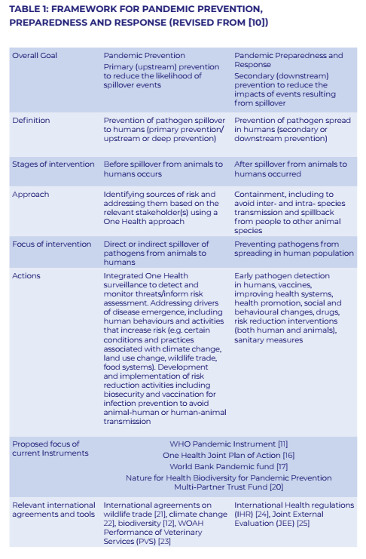
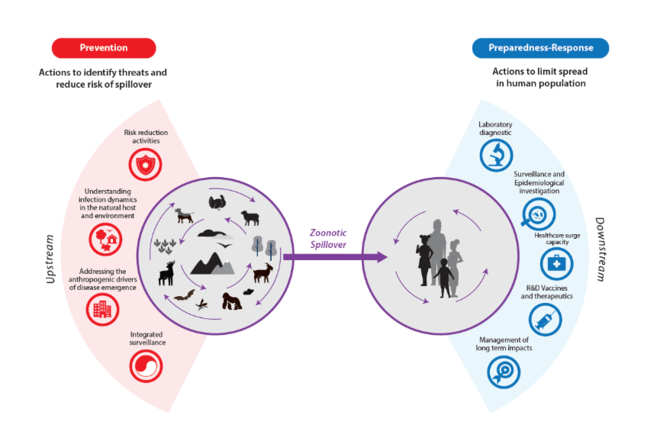

Slide 7
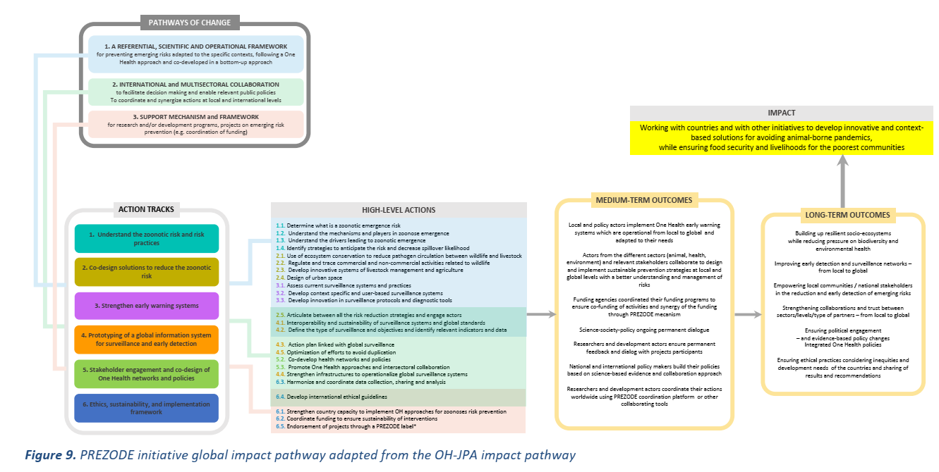

Slide 8
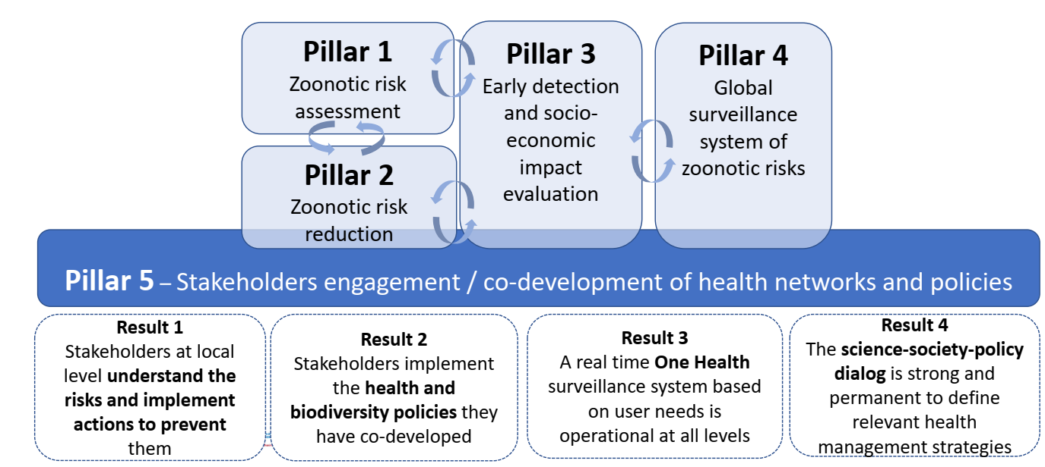

Slide 9
PREACTS 1 (AFRICAM) on pillar 1 (10 M Euros)
4 African countries
Cambodia
PREACTS 2 on pillar 2 (10 M Euros)
Central Africa (Congo)
Central America (Mexico)
Southeast Asia (Thailand-Laos)
PREACT3 on pillar 3-4 (10 M Euros)
Vietnam
?
Risk assessment
Prevention (drivers)
Risk reduction (environment)
Mitigation measures (ecosystems)
Surveillance

Slide 11
Tranche 2
PREACTS

Slide 12
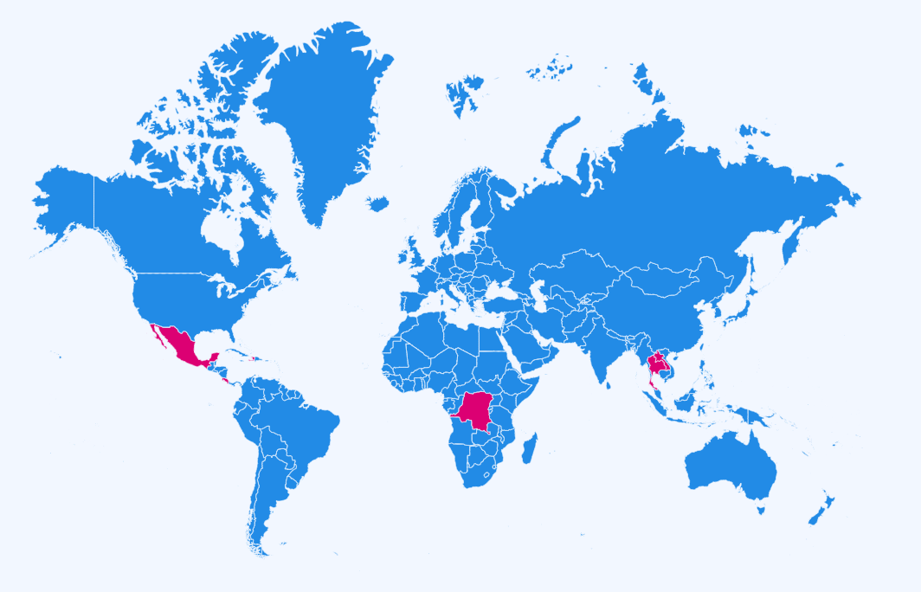
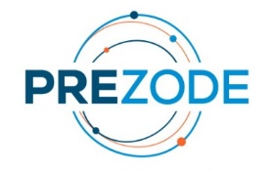
Une approche régionale Région Afrique-Centrale : République Démocratique du Congo (RDC) Point focal : Martine Peeters (IRD)/Steve Ahuka Région Asie du Sud-Est : Laos + Thaïlande Point focal : Serge Morand (CNRS) / Soawapak Hinjoy (DDC MoPH) Région Amérique et Caraïbes : Mexique, Haïti et Costa Rica Point focal : Benjamin Roche (IRD) / Gerardo Suzan
Coordination globale
Geography

Slide 13
Retroplanning

Slide 14
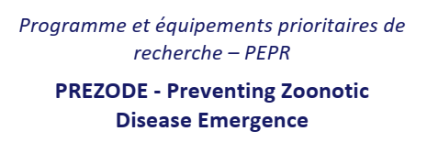
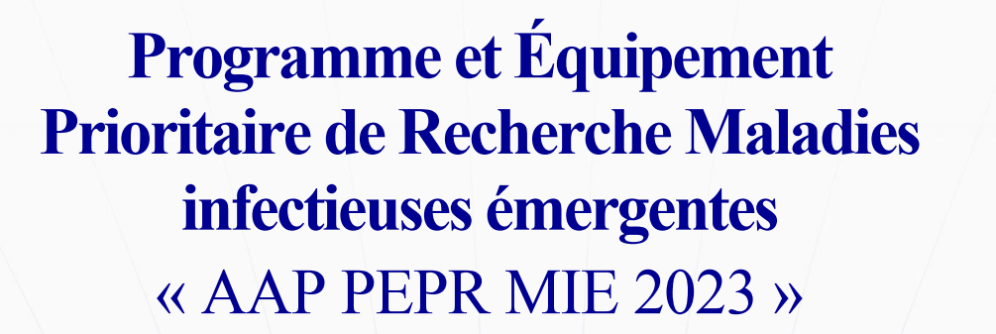
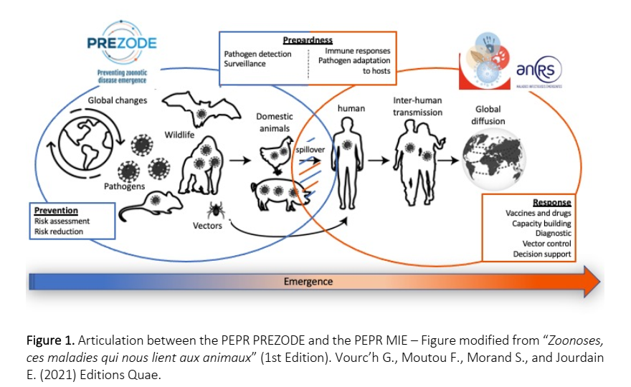

Slide 15
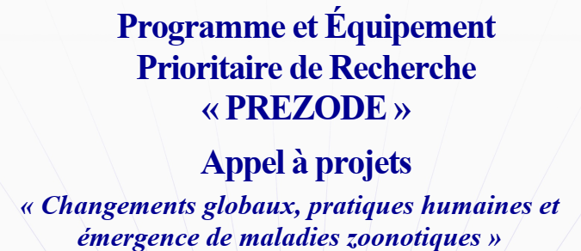
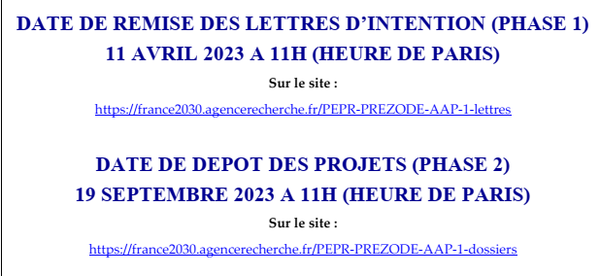
• Axis 1. Characterization and role of hosts, reservoirs and vectors, as well as their interactions, in the evolution, circulation, transmission and emergence of zoonotic pathogens in a context of global changes
• Axis 2. Characterization of the sociological, economic and environmental dimensions in the evolution, circulation and emergence of zoonotic pathogens at the human species/animal/environment interface in a context of global changes
• Axis 3. Characterization and quantification of the cascading effects between human activities, global changes, socio-economic activities, structuring of ecological communities and risks of zoonotic emergence.

Slide 16
1 to 3 MEuros for 3 to 5 years with at least 3 different units (France)
Letter of intention (5 years), no selection
scientific objectives
adequation to the call
quality and composition of the consortium
action plan
budget
strength and weakness of the project
skills needed
seminar and workshops needed to consolidate the proposal

Slide 18
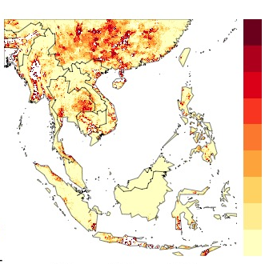
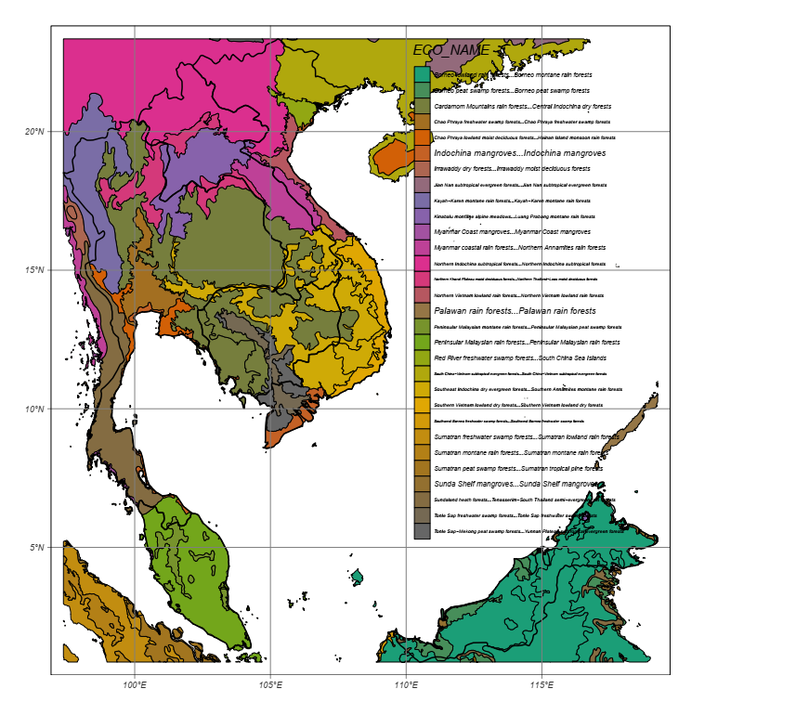
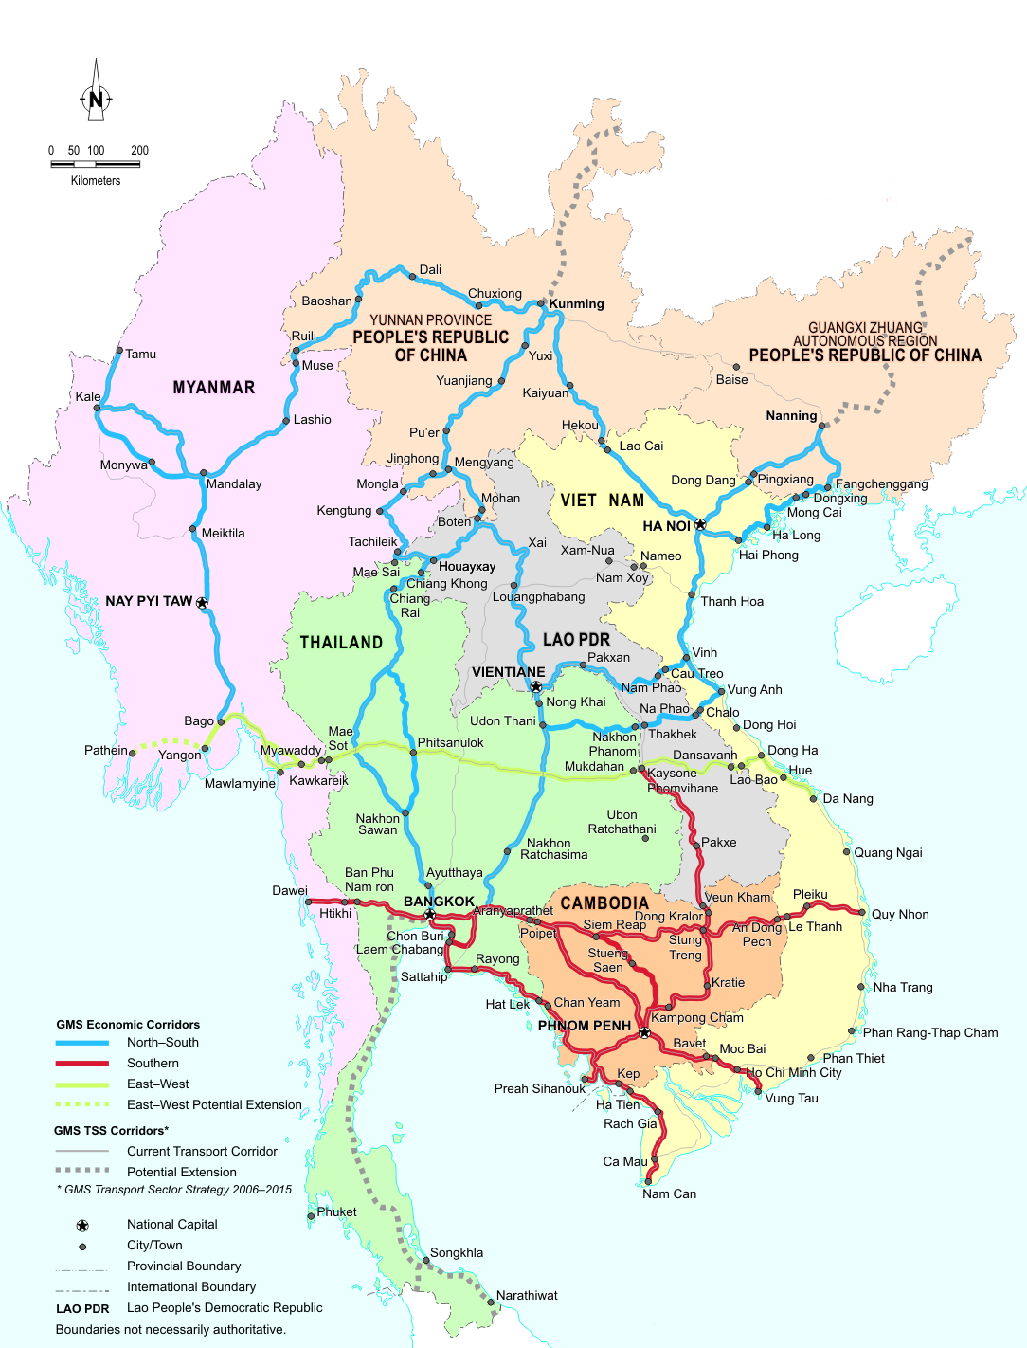
MIVEGEC
iEES
EspaceDev
HealthDEEP?
LMI PRESTO:
CICML , CMU
KU, MU
Bat, Bird, Rodent & Vector-borne diseases (BBRV-borne)
Emergence risks at the ecosystem level in Southeast Asia
(Pillar 1)
cattle
Ecoregions
interface
Economic corridors

