Slide 1
Frist meeting of the International Joint Laboratory PRESTO (PRotect-dEtect-STOp)
“What research to conduct to prevent and prepare for future outbreaks/pandemics?”
14 Mar 2023, Green Lake Hotel, Chiang Mai, Thailand

Slide 2
Who are we?
Sabrina LOCATELLI, PhD
Nicole NGO-GIANG-HUONG, PharmD, PhD
Woottichai KHAMDUANG, PhD
Molecular biologist, researcher
MIVEGEC, IRD
Retroviruses, opportunistic and neglected tropical diseases at the human/animal interface.
At CILM-IRD-Laos since August 2021
Virologist, researcher
MIVEGEC, IRD
AMS-IRD collaboration, Thailand
Mother-to-child viral transmission, clinical trial
Viral drug resistance
Virologist, Assistant professor
Faculty of Associated Medical Sciences, Chiang Mai University (AMS-CMU)
Molecular virology, epidemiology

Slide 3
Where do we work and with whom?
Thailand
Chiang Mai University
Faculty of Associated Medical Sciences
Faculty of Science
Faculty of Veterinary Medicine
Mahidol University, Faculty
of Tropical Medicine
Kasetsart University.
Faculty of Veterinary
Technology
France
Montpellier University, Faculty of Science
Laos
University of Health Sciences
National University of Laos (NUOL)
National Animal Health Laboratory
Centre Infectiologie Lao Mérieux

Slide 4
Why?
Global hotspot of biodiversity
Potential hotspot for spillover events
Viral zoonoses (i.e., Nipah/Hendra virus infection, H1N1 Swine flu, SARS, COVID-19)
Development of economic corridors and their integration into the new Silk Roads
Climate change and human activities leading to biodiversity loss
Southeast Asia (SEA) - Greater Mekong region

Slide 5
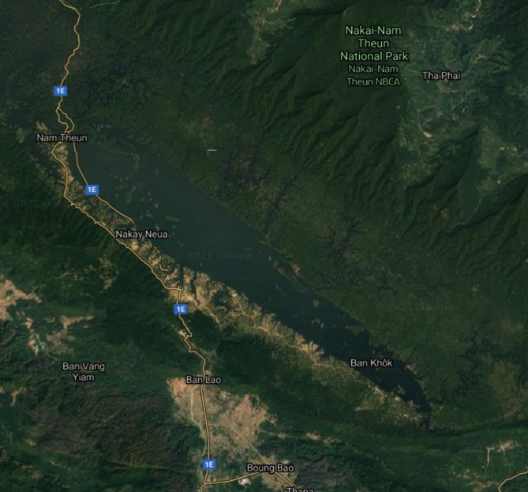
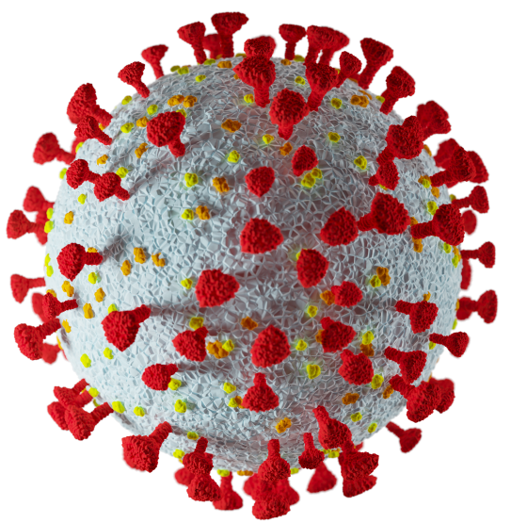
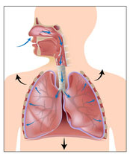
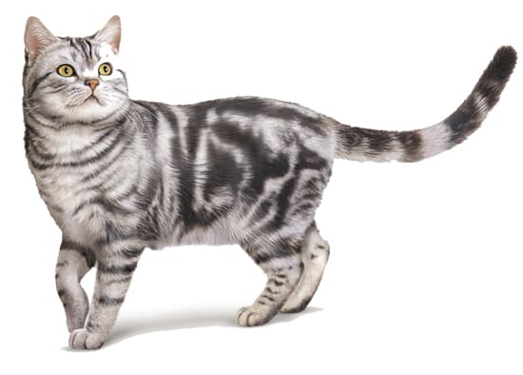
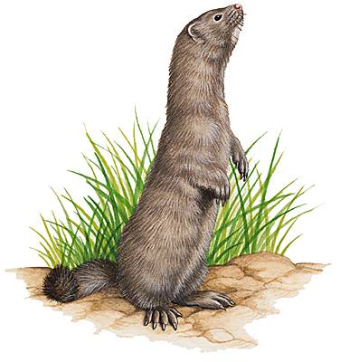
How ?
LONG-TERM SCIENTIFIC OBJECTIVES: To understand how new zoonotic infections can emerge, spread, and how they can be stopped
Identification of biodiversity rich areas/ anthropogenic pressure
Molecular characterization /epidemiology of pathogens of zoonotic potential
Identification of animal reservoirs
Identification of behavior risks of exposure and susceptible human populations
New detection tests/ validation

Slide 6
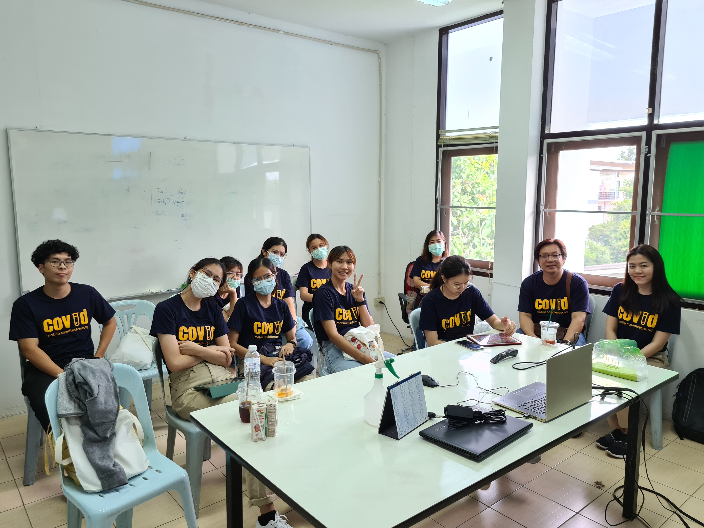
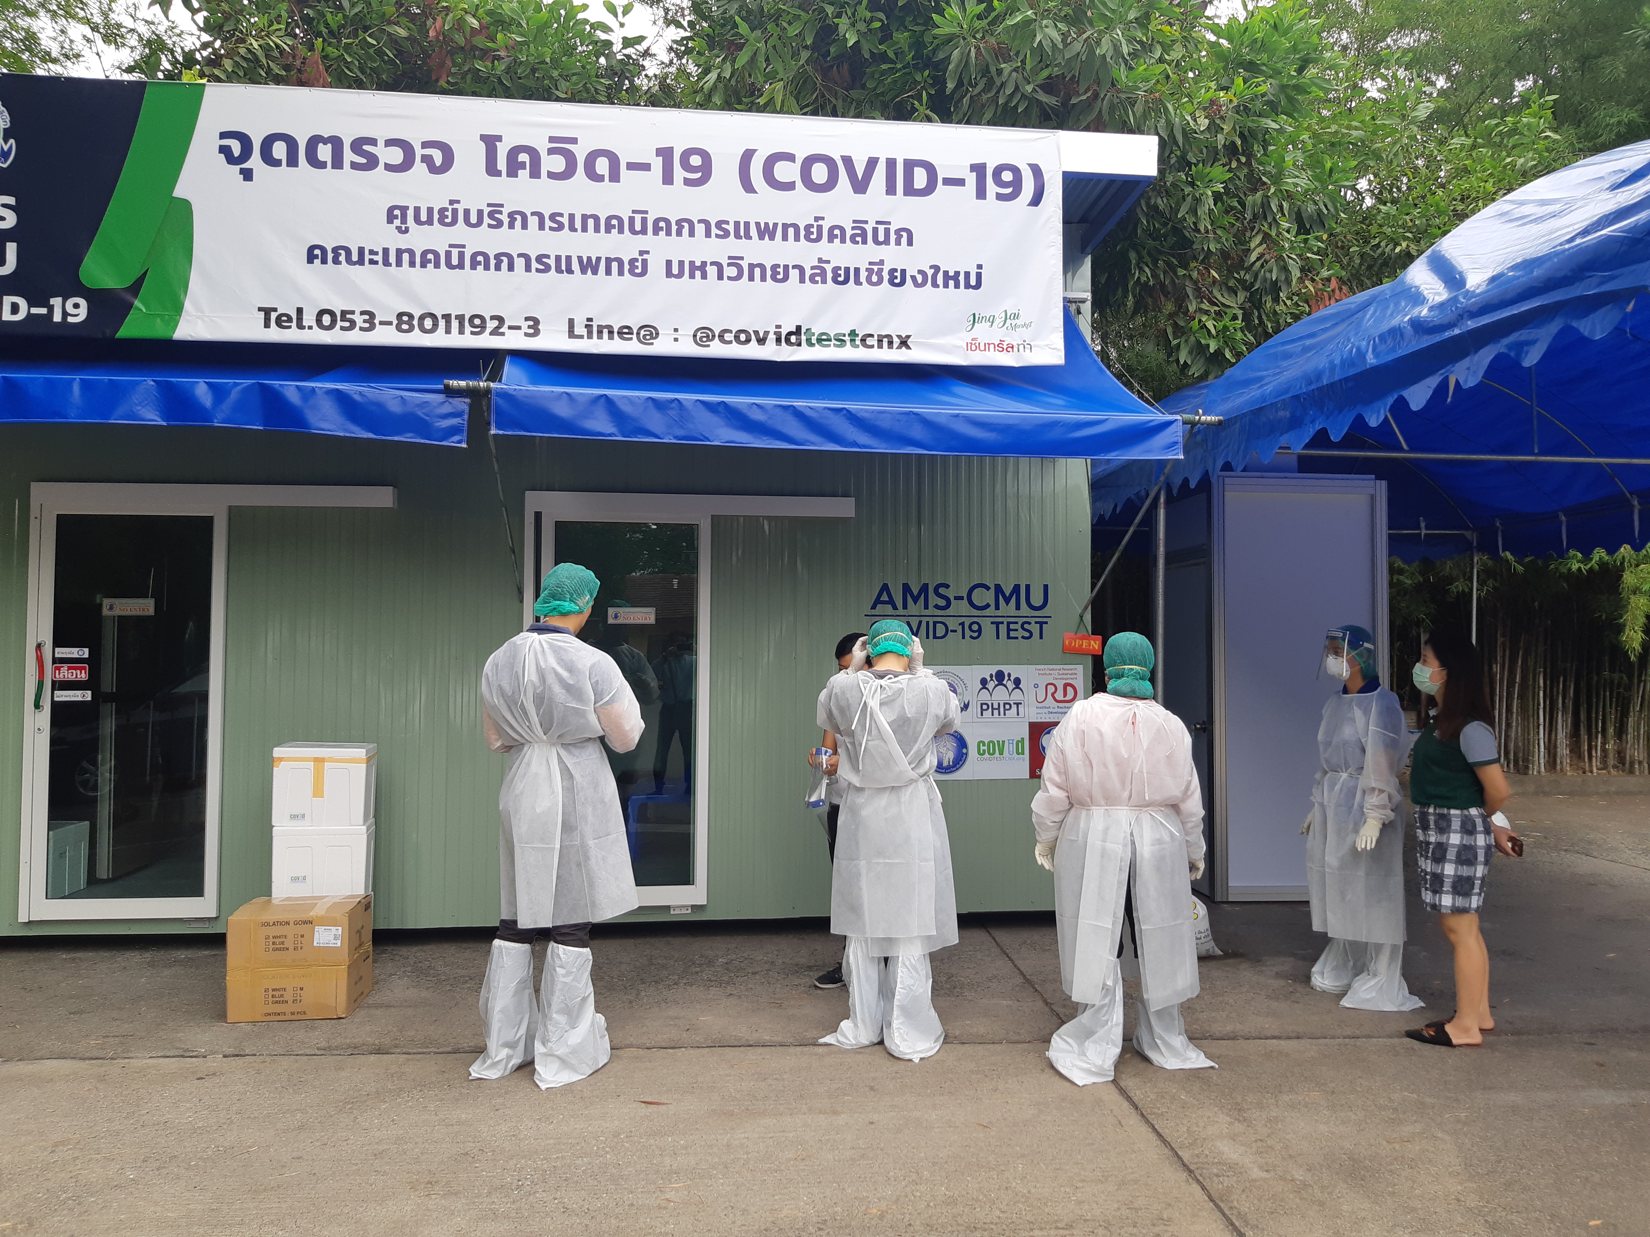
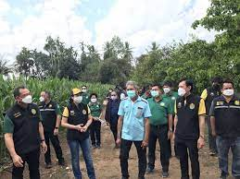
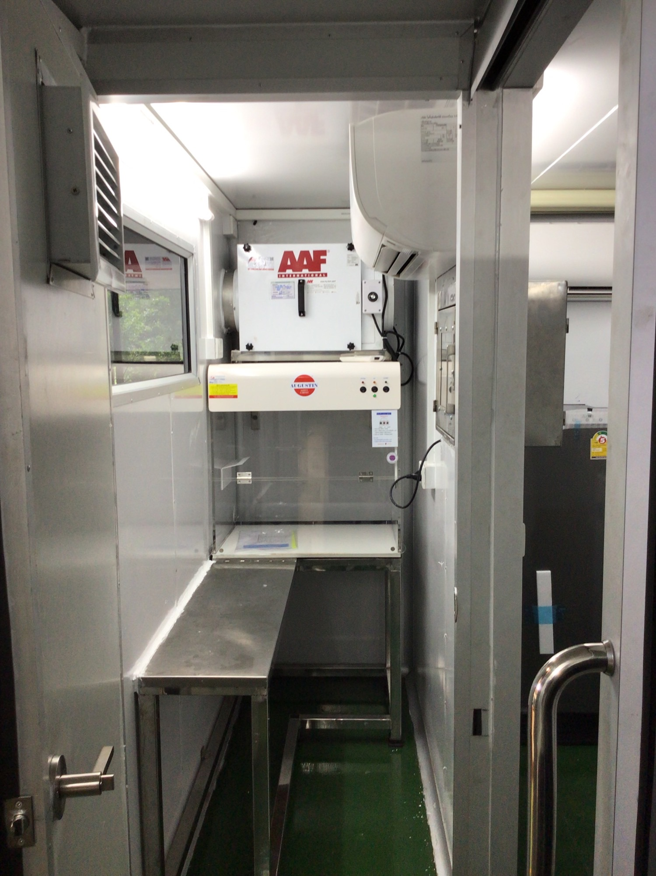
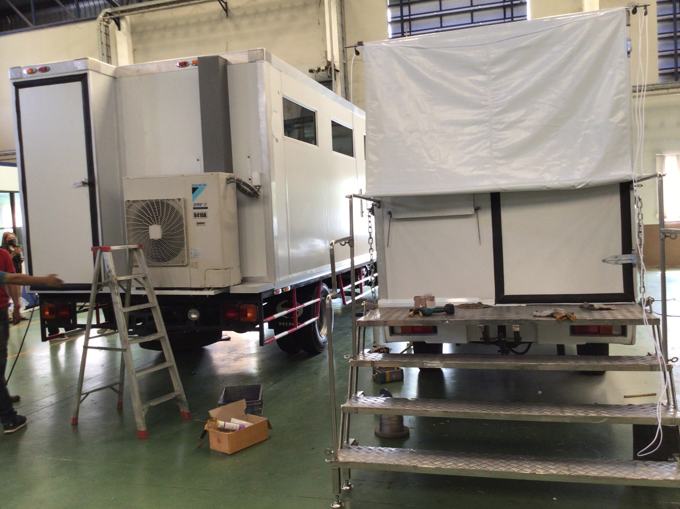
Develop/Strengthen Capacity
At the individual level
one-on-one or group training –development of MOOC (international accreditation)
Mentorship
At the IJL level
Networking with other initiatives
Forging partnerships with national institutions and NGOs : PRESTO Symposium (first semester 2023)
Empowering local communities and advocate for diseases surveillance
Investing in new technological innovations

Slide 7
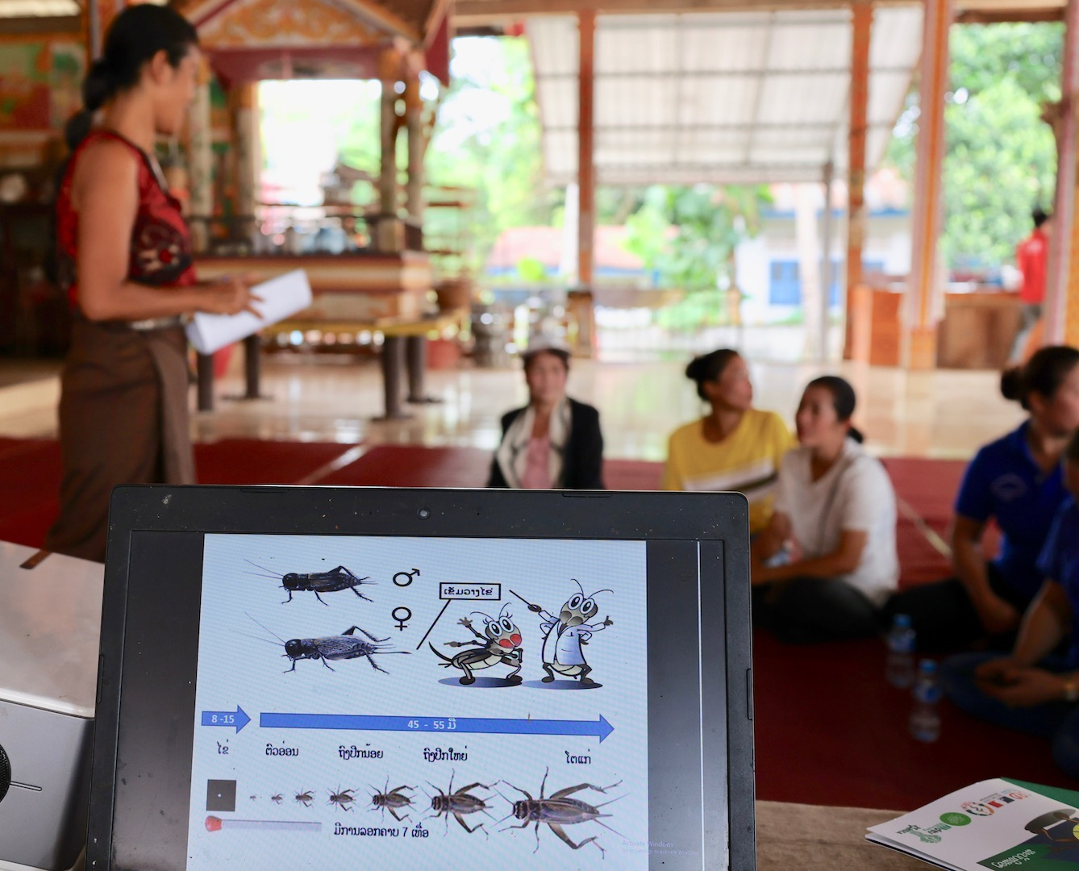
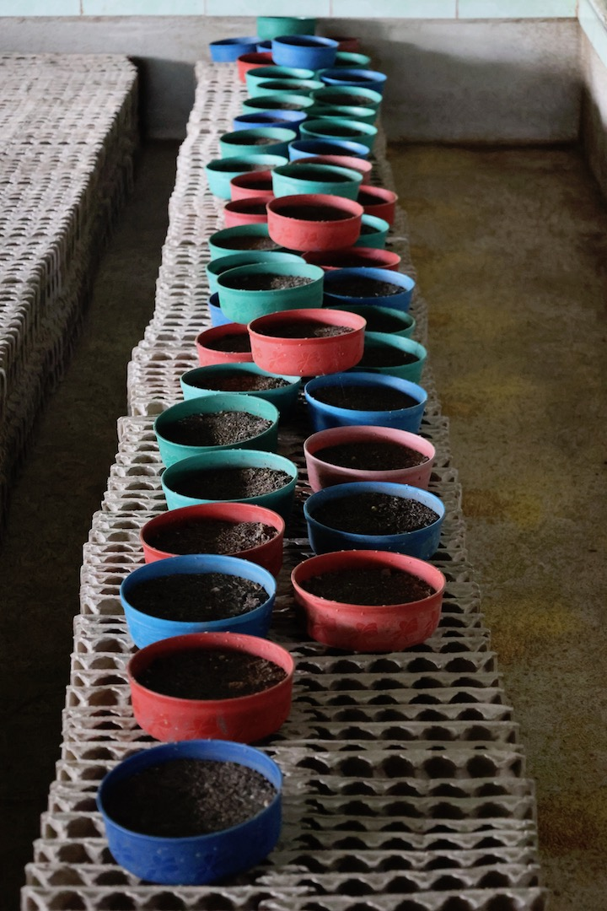
Ongoing projects
LAOS
ROCKET
- Research On CricKET
Low-cost/High-Tech production of edible crickets for sustainable agriculture and women empowerment in Laos ( A Private/Public South-North Consortium)
PRotect
DEHARO Eric
LOCATELLI Sabrina
Fondazione A.L.A. per l’Aiuto Umanitario
© Sabrina LOCATELLI
https://en.ird.fr/rocket-project-information-and-recruitment-stage-future-cricket-breeders
https://rocket.ird.fr

Slide 8
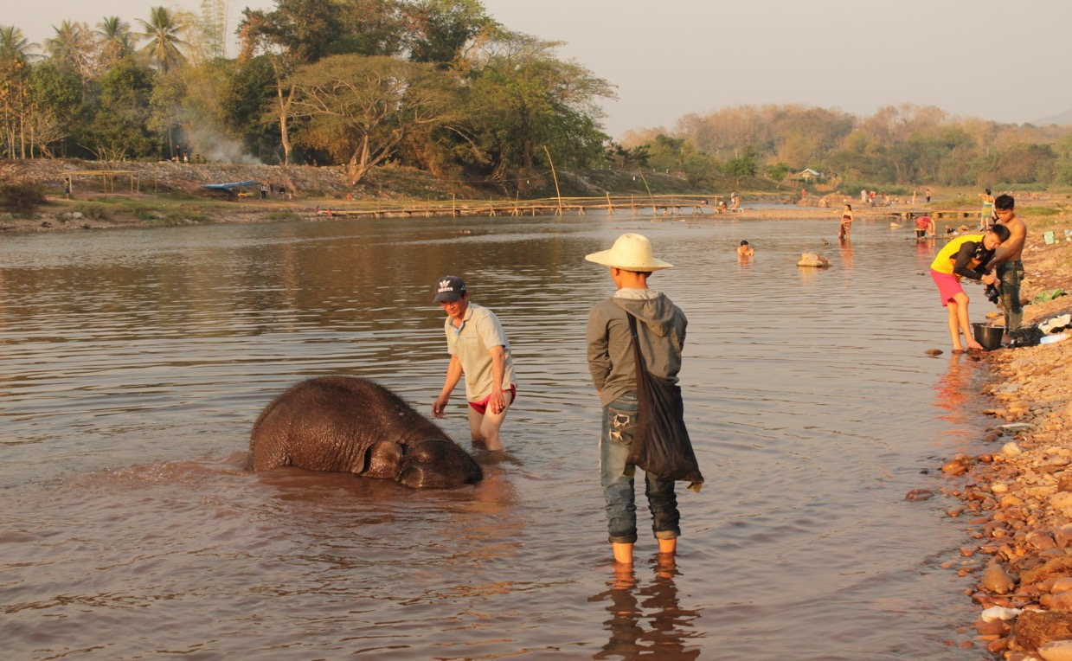
The Emergence of Tuberculosis at the Human-Elephant Interface
ELAOS-ELephAntuberculOSis
LAOS
LOCATELLI Sabrina
PABORIBOUNE Phimpha
BELEN LOPEZ PEREZ Ana
SAYASONE Somphou
PHAKEOVILAY Chiobouaphing
© Colette Gaillard
dEtect
PRotect
CHENG Sokleaph
CAMBODIA

Slide 9
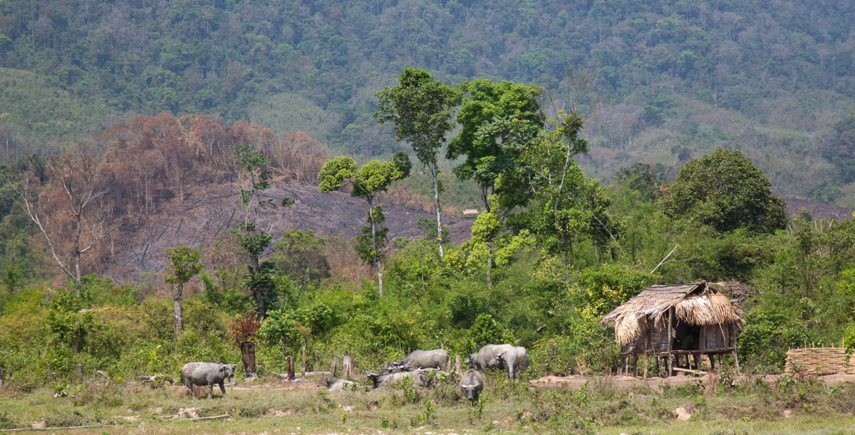
A One-Health approach to estimate the prevalence and genetic diversity of gastrointestinal pathogens circulating among elephants, domesticated bovines and the human population living at the edge of the Nakai-Nam Theun National Park, Laos
ONENAKAI
LAOS
LOCATELLI Sabrina
COUDRAT Camille
SAYASONE Somphou
PHAKEOVILAY Chiobouaphing
THEPPANGNA Watthana
Association ANOULAK ©
GOSSENS Benoit
PRotect
dEtect
MALAYSIA

Slide 10
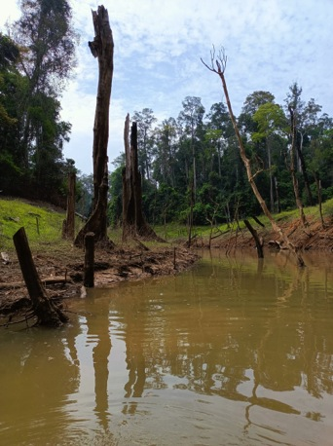
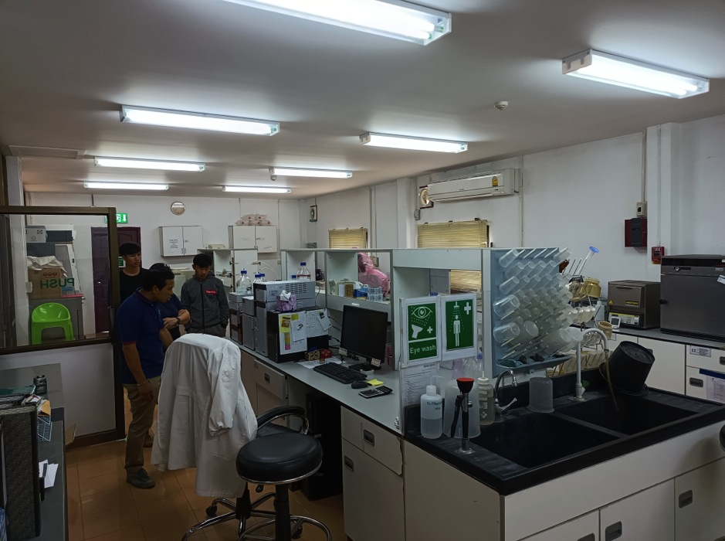
LAOS & THAILAND
Nakai International Environnemental Research
Centre- dedicated to One-Health Research
CIREN
PRotect
dEtect
DEHARO Eric
LOCATELLI Sabrina
PRAVONG Vatsana
A consortium of researchers and Institutions from Laos, Thailand and France

Slide 11
LAOS & THAILAND
LEROY Eric
DEHARO Eric
LOCATELLI Sabrina
MORAND Serge
PABORIBOUNE Phimpha
LATTHAPHASAVANG
Vatthanaphone
AR GOUILH Meriadeg
KRITIYAKAN Anamika
LACOVISS
Epidemiological investigation of SARS-CoV-2 in Laos using a One-Health approach
dEtect
DISCOVER
Natural history of SARS-CoV-2 :
Emergence and Reservoir
© Nicola Gasperini

Slide 12
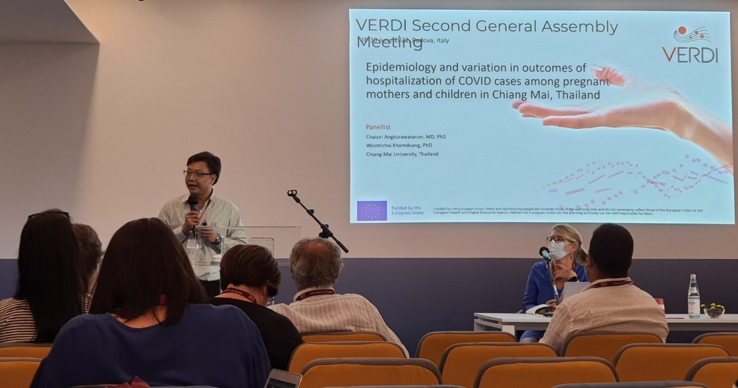
THAILAND
SARS-CoV-2 variants Evaluation in pRegnancy and paeDIatrics cohorts
GIAQUINTO Carlo
and PENTA team
KHAMDUANG Woottichai
ANGKURAWARANON
Chaisiri
NGO-GIANG-HUONG Nicole
dEtect
STOp
Notes:
Pathogen identification, diagnosis and outbreak mitigation

Slide 13
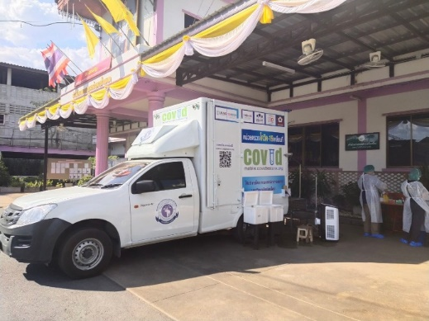
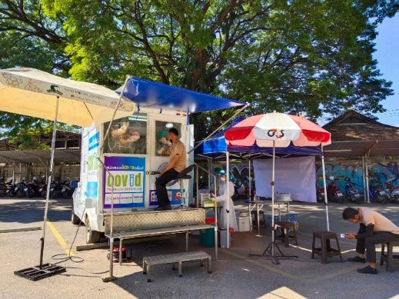
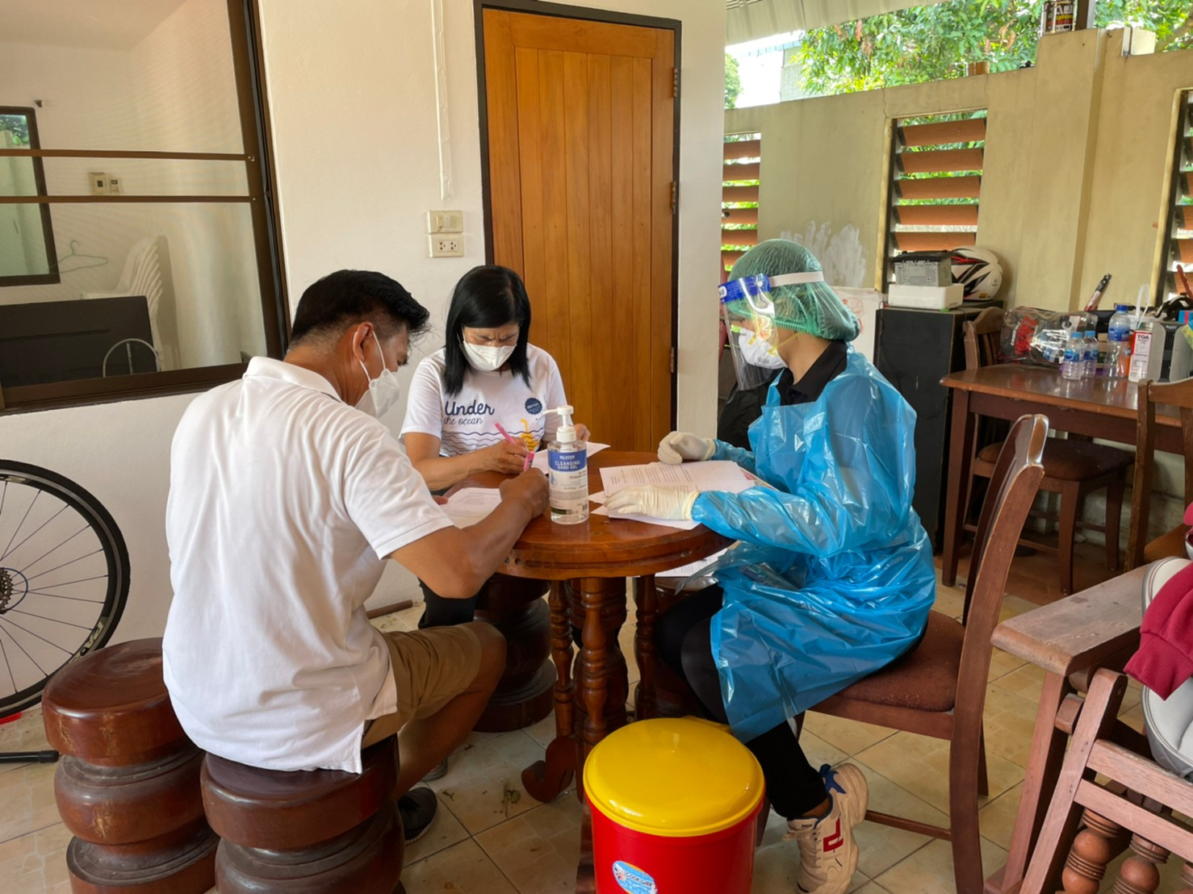
THAILAND
Development of point-of-care testing for SARS-CoV-2
KHAMDUANG Woottichai
HONGJAISEE Sayamon
NGO-GIANG-HUONG Nicole
PANPRADIST Nuttada
dEtect
STOp
Notes:
Rapid detection of SARS-CoV-2 using colorimetric loop-mediated isothermal amplification assays

Slide 14
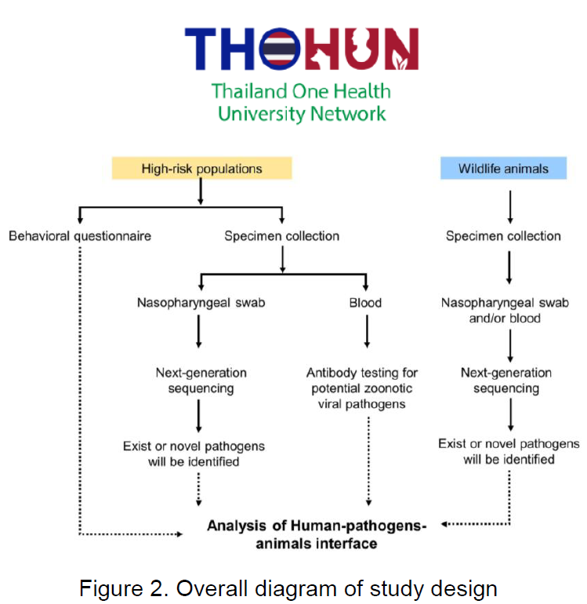
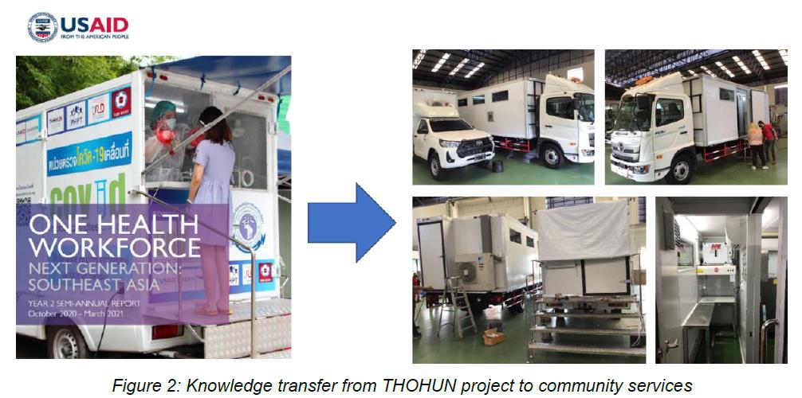
Survey of zoonotic viruses in wildlife and high-risk human populations in Chiang Mai Province
KHAMDUANG Woottichai
PORNPRASERT Sakorn
NGO-GIANG-HUONG Nicole
dEtect
STOp

Slide 15
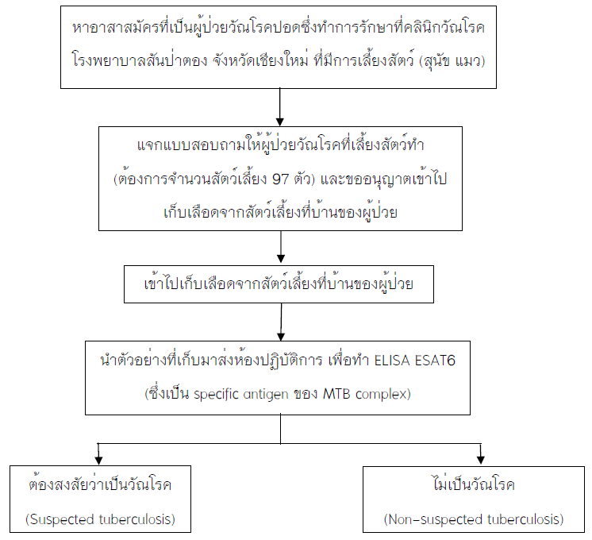
Survey of tuberculosis in household pets living in pulmonary tuberculosis patient house
Anucha Sirimalaisuwan, VMD, PhD
Veterinary Public Health Unit, Faculty of Veterinary Medicine, Chiang Mai University
dEtect
STOp
Pets with suspected tuberculosis will be further examined with:
Chest X-ray
Throat swab will be collected for TB diagnosis
If the pet found to be positive with TB, he/she will be referred to care in pet clinic

Slide 16
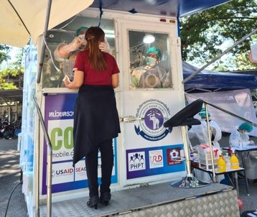
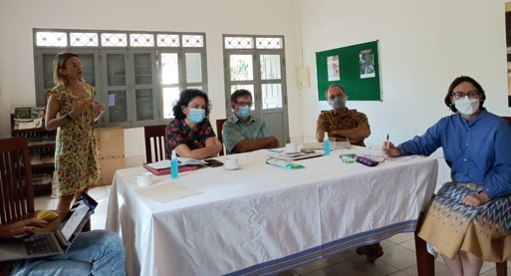
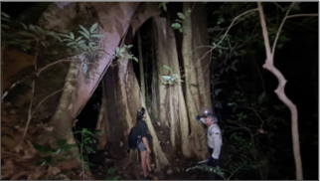
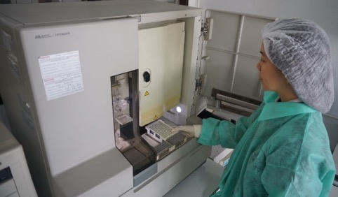
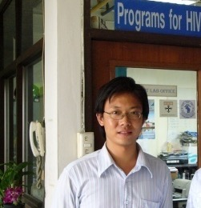
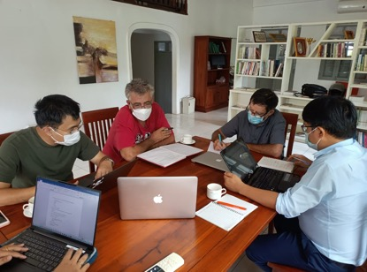
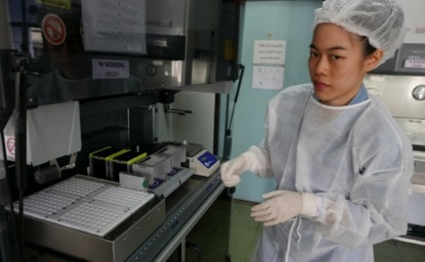
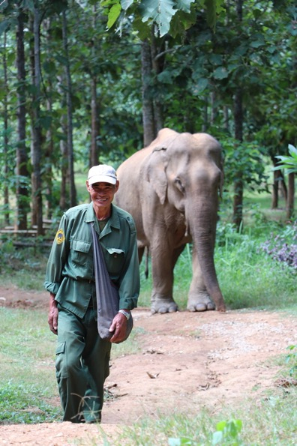
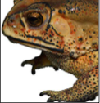
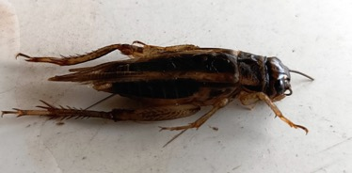
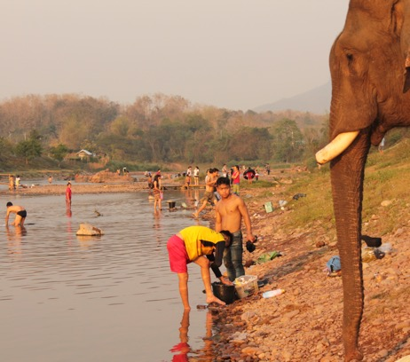
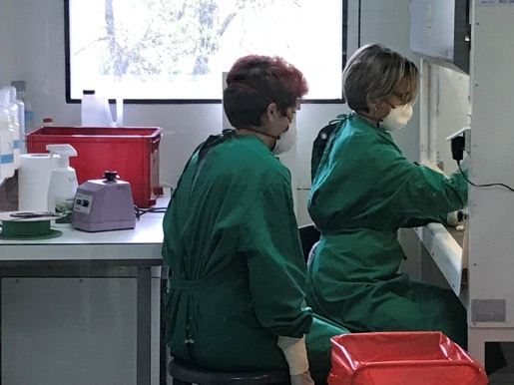
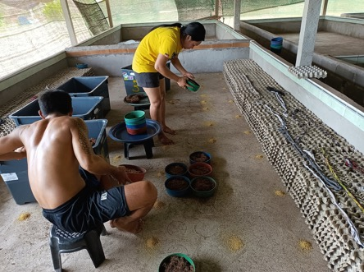
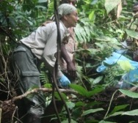
Thank you for your attention!

